Slide 1

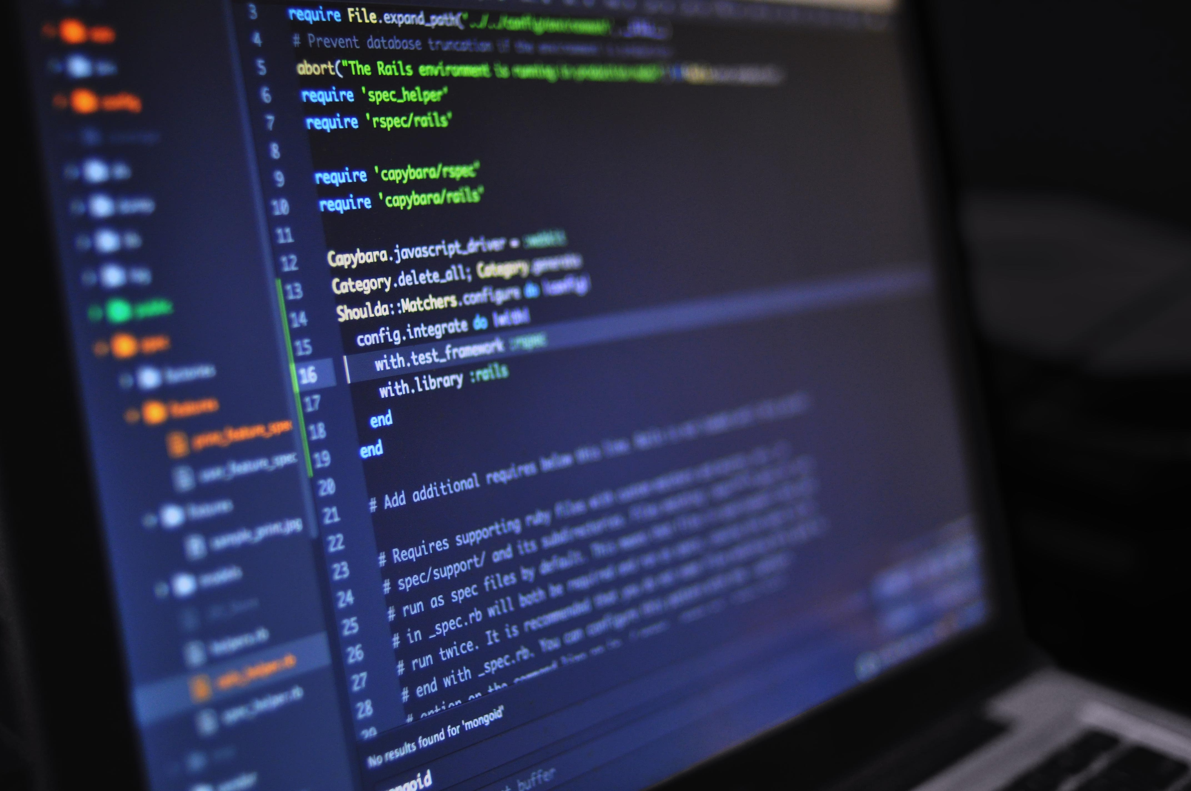
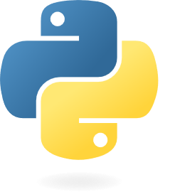

Lesson 01:
Introduction & Background
First installation
Python Programs Editors (Console, text & IDE)
Write your first program
Basic Data Types
Input - Output
Operations on strings & numbers
Data flows, Conditions & Loops
Mutable vs Immutable Data Types
Python for beginners
with applications
Write code from scratch in a clear & concise way, through a complete basic course.
From beginners to intermediate.
Abdesselam Filali 2025-11-26 19h00 Algiers time

Slide 2


Python for Beginners with applications – Lesson 01
No special programming background needed.
Internet access
A clean installation of Python (see https://www.python.org Download & install the latest version)
A text editor (notepad, notepad++, Sublimetext, …)
Visual Studio Code, Pycharm or Anaconda
Jupyternotes or Jupyterlabs
The presentation and the code used will be available on
https://github.com/Abdou-fi/python/tree/main/2025-2026/Course_01
Materials needed (Python Course 01)

Slide 3
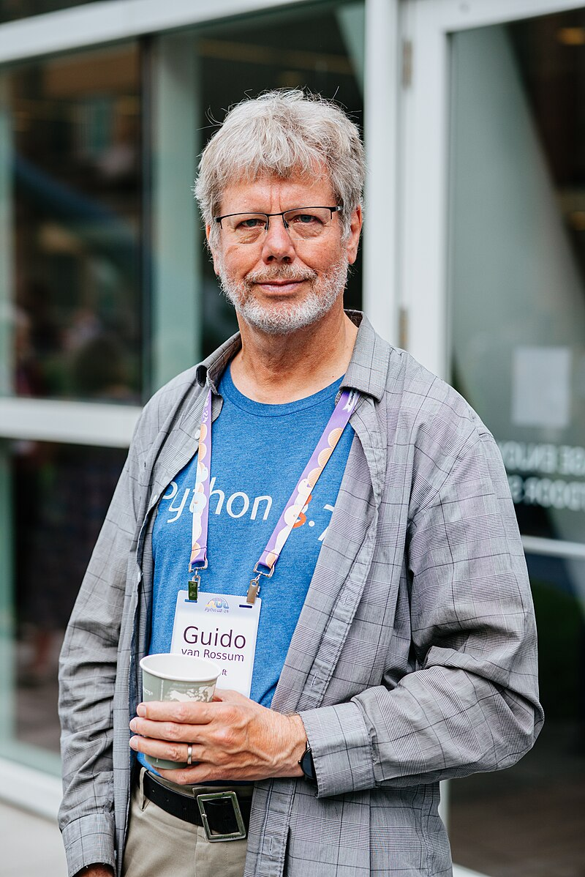






Python for Beginners with applications – Lesson 01
1.
Introduction & Background
-
History
Guido van Rossum began working on Python in the late 1980s as a successor to the ABC programming language and first released it in 1991 as Python 0.9.0. Python 2.0 was released in 2000. Python 3.0, released in 2008, was a major revision not completely backward-compatible with earlier versions. Python 2.7.18, released in 2020, was the last release of Python 2.
Python consistently ranks as one of the most popular programming languages and has gained widespread use in he machine learning community.
Learning Scientific Programming with Python is intended to help scientists and engineers learn version 3 the Python programming language and its associated NumPy, SciPy, pandas and Matplotlib libraries. No prior programming experience or scientific knowledge in any particular field is assumed. However, familiarity with some mathematical concepts such as trigonometry, complex numbers and basic calculus is helpful to follow the examples and exercises.

Slide 4
Python for Beginners with applications – Lesson 01
1.
Introduction & Background
-
Definitions
Python is a high-level, general-purpose programming language. Its design philosophy emphasizes code readability with the use of significant indentation.
Python is dynamically type-checked and garbage-collected. It supports multiple programming paradigms, including structured (particularly procedural), object-oriented and functional programming. It is often described as a "batteries included" language due to its comprehensive standard library.
https://docs.python.org/3/
It is an interpreted language (JIT, machine code)

Slide 5
Python for Beginners with applications – Lesson 01
1.
Introduction & Background
-
Generalities
Programming languages
Markup
SQL
interpreted
compiled
HTML / XML
T-SQL – PLSQL
Scripting / Python JavaScript, VBA, PHP
C++ C# MatLab Fortran Rust
Compiled code is translated into machine code before execution, resulting in faster performance and an executable file, while interpreted code is translated line by line as it runs, offering easier debugging and portability. Compiled programs run faster but lack portability, as they are platform-specific, whereas interpreted programs run on any machine with the correct interpreter but can be slower.
Feature | Compiled | Interpreted
Translation | Entire source code translated to machine code before execution. | Source code translated and executed line-by-line at runtime.
Performance | Generally faster because it's pre-compiled machine code | Generally slower due to the overhead of translating each line during execution.
Portability | Lower portability; the executable is specific to the operating system or CPU. | Higher portability; the source code can run on any machine with a compatible interpreter.
Error Detection | Errors are caught during compilation, before the program runs. | Errors are caught during runtime, as the interpreter finds them line by line.
Development | Longer development cycle due to the compile-link-run steps. | Faster development cycle; easy to test and edit code on the go.
Code Distribution | Provides the executable file, keeping the source code private. | Requires the source code to be distributed, making it more public.
Examples | C, C++, Rust | Python, JavaScript, VBA

Slide 6
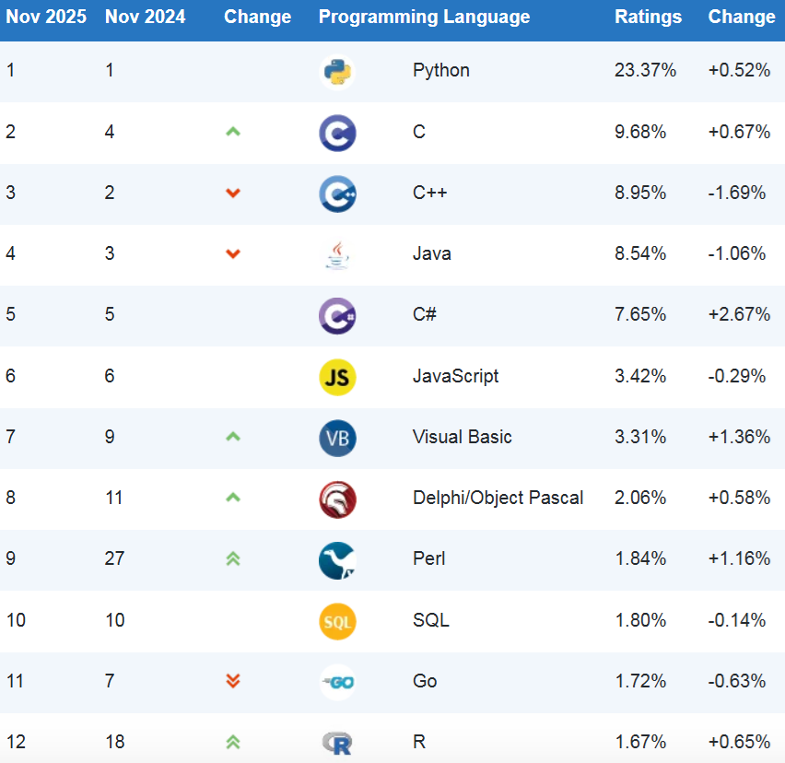
Python for Beginners with applications – Lesson 01
1.
Introduction & Background
-
Ranking TIOBE index
REASONS WHY _ THE MASSIVE POPULARITY OF PYTHON WILL REMAIN INTACT IN THE FUTURE
Supports Multiple Programming Paradigms
Doesn't Require Programmers to Write Lengthy Code
Provides a Comprehensive Standard Library
Effectuates Web Application Development
Facilitates Development of High-Quality GUI, Scientific and Numeric applications
Simplifies Prototyping of Applications
Can also be used for Mobile App Development
Open Source
Easy to learn
Versatile
Large community
High demand
Excel

Slide 7
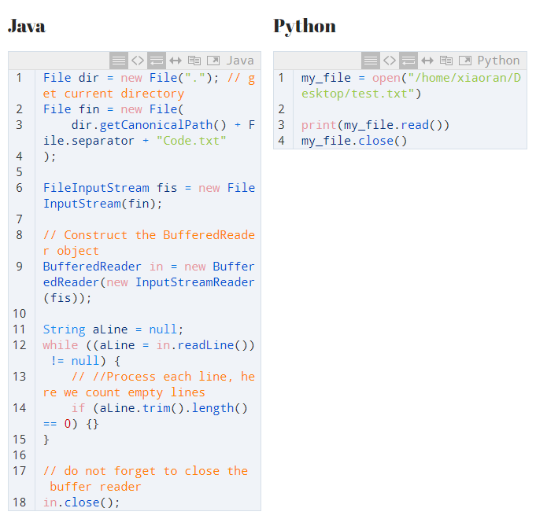
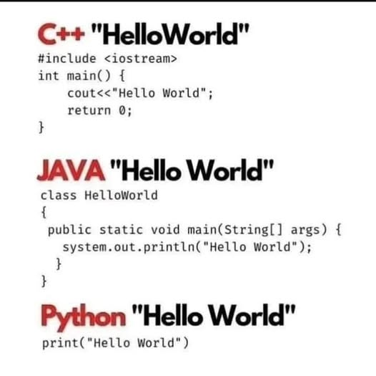
Python for Beginners with applications – Lesson 01
1.
Introduction & Background
-
Syntax

Slide 8
Python for Beginners with applications – Lesson 01
1.
Introduction & Background
-
Use
Interpreted
Memory management
Dynamically Typed
Embeddable
Object oriented
Large Ecosystem
Desktop Apps
Gaming
Data Science
Web Apps
AI/ML
IoT
Robotics
Mobile Apps
Scripting

Slide 9
Python for Beginners with applications – Lesson 01
1.
Introduction & Background
-
Use
Python
+
NumPy
=
Arrays + Matrices
Python
+
Pandas
=
Data Manipulation
Python
+
Scikit-Learn
=
Machine Learning
Python
+
Tensorflow
=
Deep Learning
Python
+
Matplotlib
=
Data Visualisation
Python
+
Seaborn
=
Adv. Visualisation
Python
+
Flask
=
Web Development
Python
+
Django
=
Web Development
Python
+
Pygame
=
Game Development
Python
+
Kivy
=
Mobile App development

Slide 10
Python for Beginners with applications – Lesson 01
1.
Introduction & Background
-
Ressources
Ressources (Tutorials):
https://www.youtube.com/watch?v=nLRL_NcnK-4 (Harvard)
https://ocw.mit.edu/courses/6-0001-introduction-to-computer-science-and-programming-in-python-fall-2016/ (MIT)
https://www.youtube.com/watch?v=LamjAFnybo0
https://www.youtube.com/watch?v=qgUd24sQjBc&list=WL&index=5
https://www.youtube.com/watch?v=eWRfhZUzrAc&list=PLWKjhJtqVAbnqBxcdjVGgT3uVR10bzTEB
https://www.youtube.com/watch?v=ix9cRaBkVe0&list=PLZPZq0r_RZON03iKBjYOsOKr1-TD7z2lH
https://www.youtube.com/watch?v=9OgOay9bRU8
https://www.youtube.com/watch?v=37YPyDx7Zj8

Slide 11
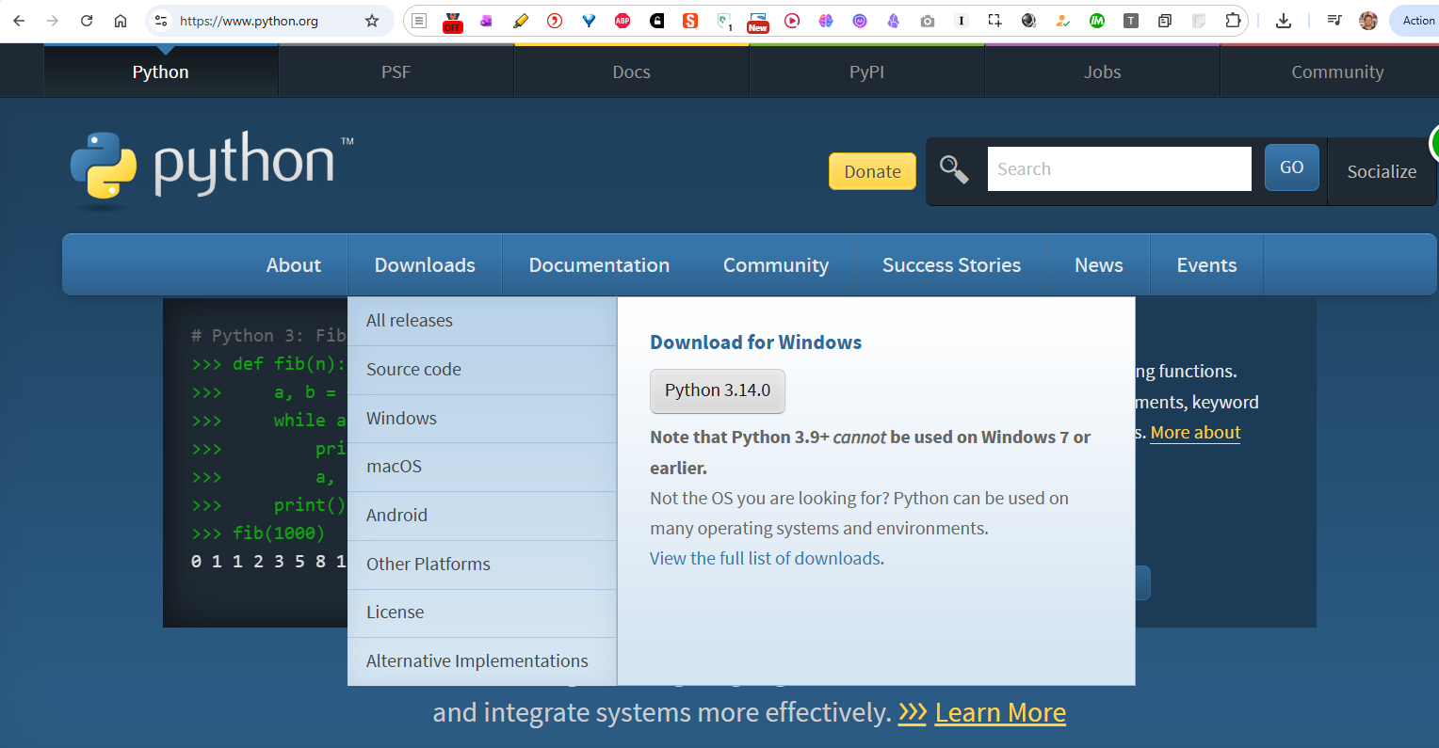
Python for Beginners with applications – Lesson 01
1.
Installation
-
Installation

Slide 12
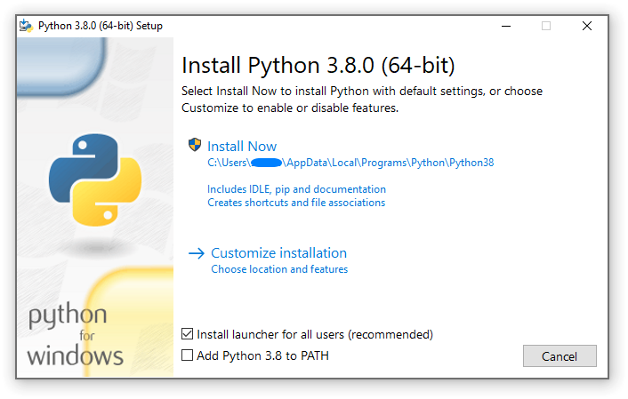
Python for Beginners with applications – Lesson 01
1.
Installation
-
Installation

Slide 13
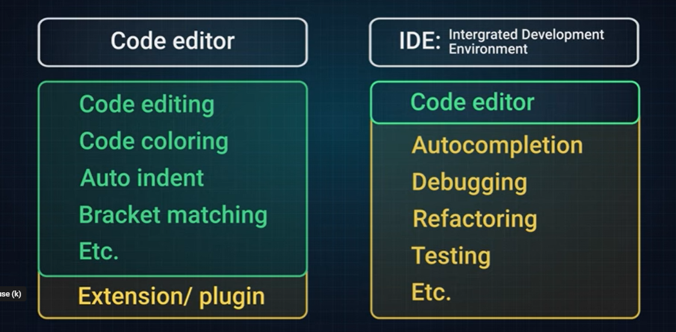

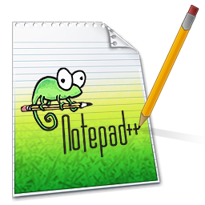

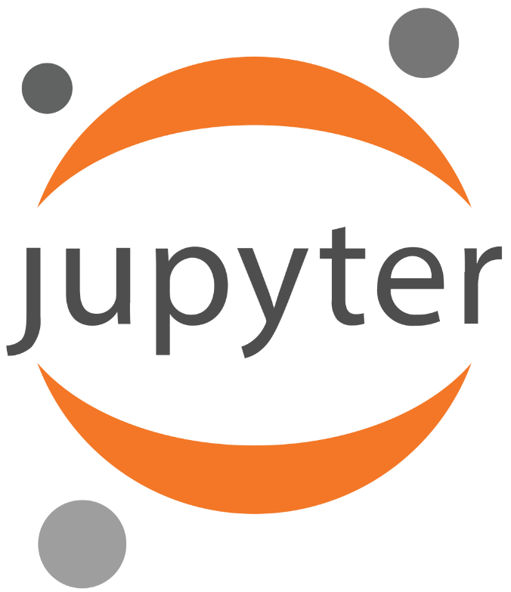
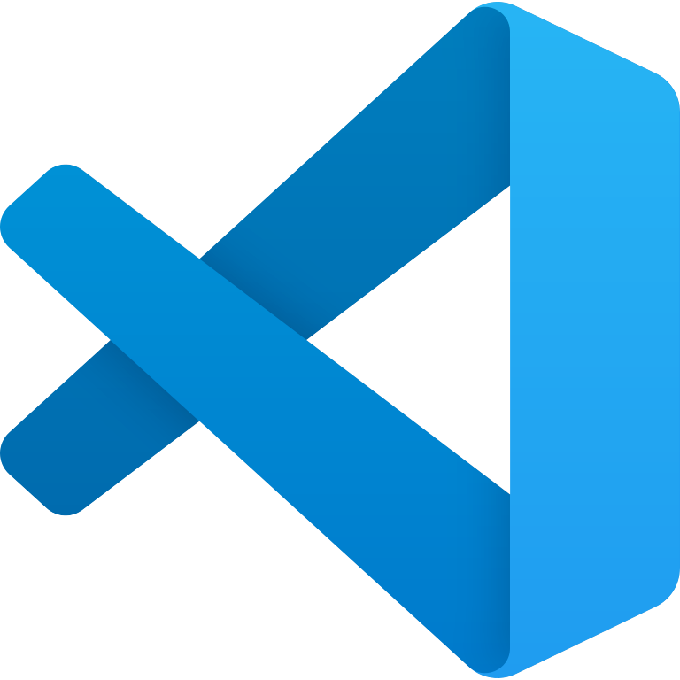
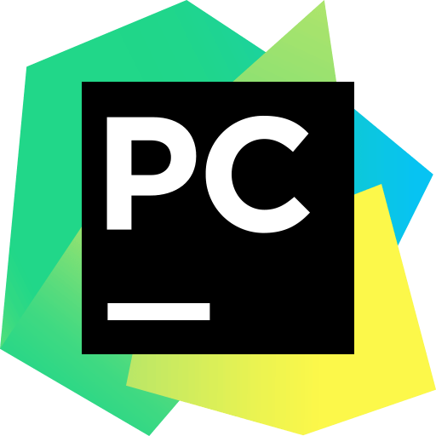
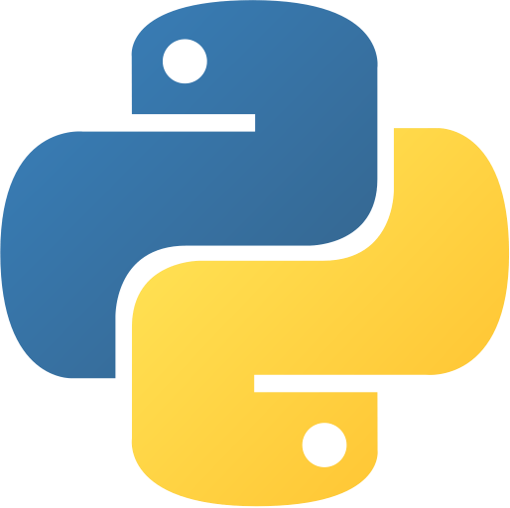


Python for Beginners with applications – Lesson 01
1.
Installation
-
Editors
https://www.online-python.com/

Slide 14

Python for Beginners with applications – Lesson 01
1.
Installation
-
Editors
https://code.visualstudio.com/download
https://www.jetbrains.com/pycharm/download
https://www.online-python.com/

Slide 15
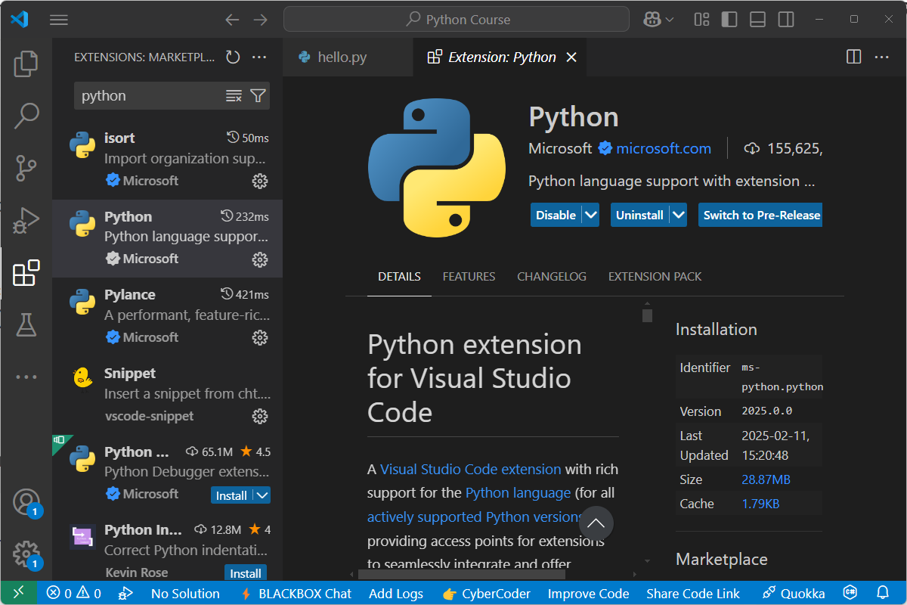
Python for Beginners with applications – Lesson 01
1.
Installation
-
Visual Studio Code

Slide 16
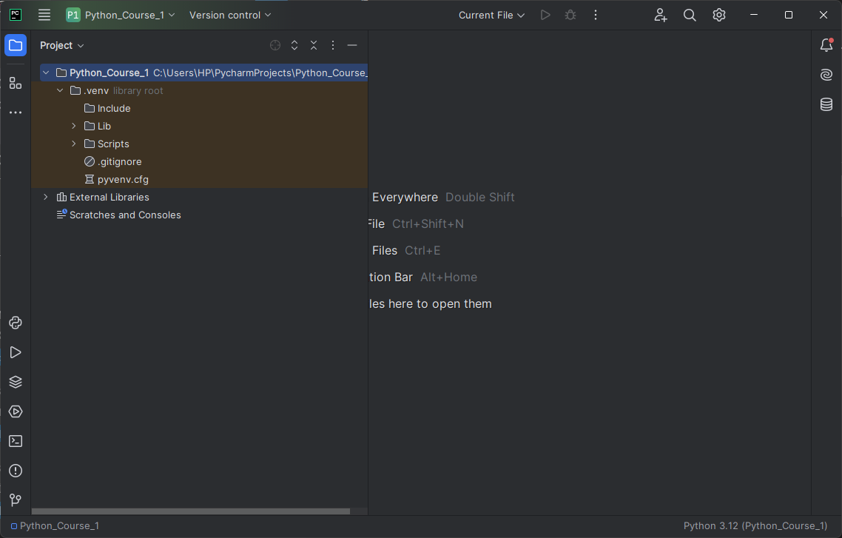
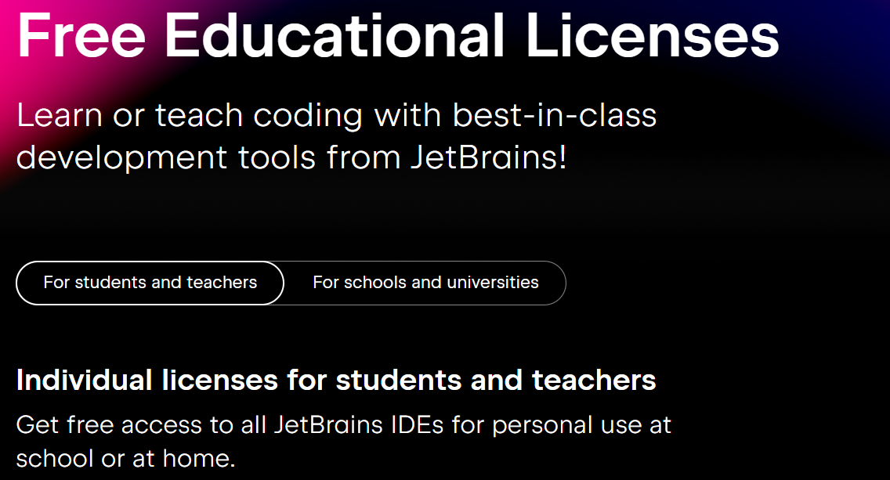
Python for Beginners with applications – Lesson 01
1.
Installation
-
PyCharm

Slide 17
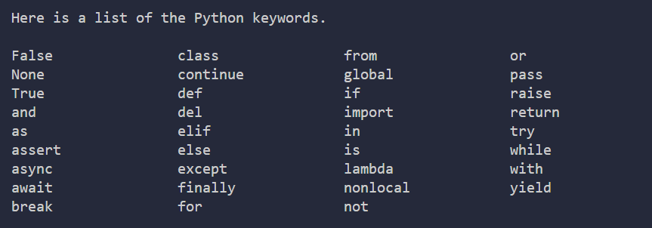
Python for Beginners with applications – Lesson 01
1.
Introduction & Background
-
Practice

Slide 18
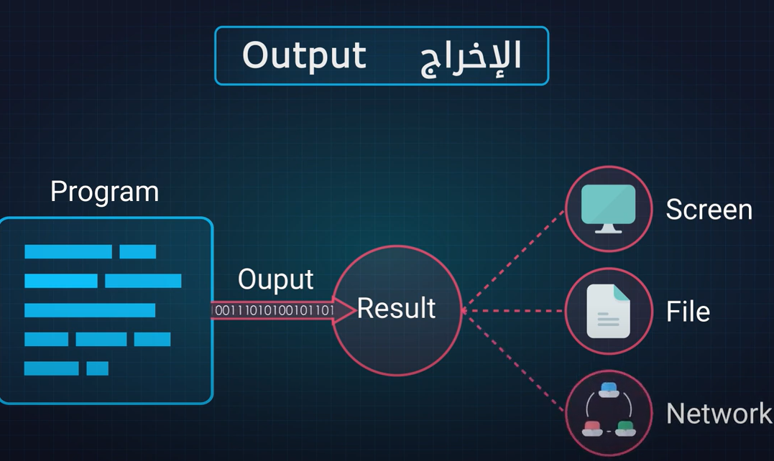
Python for Beginners with applications – Lesson 01
1.
Introduction & Background
-
Practice
Practice

Slide 19
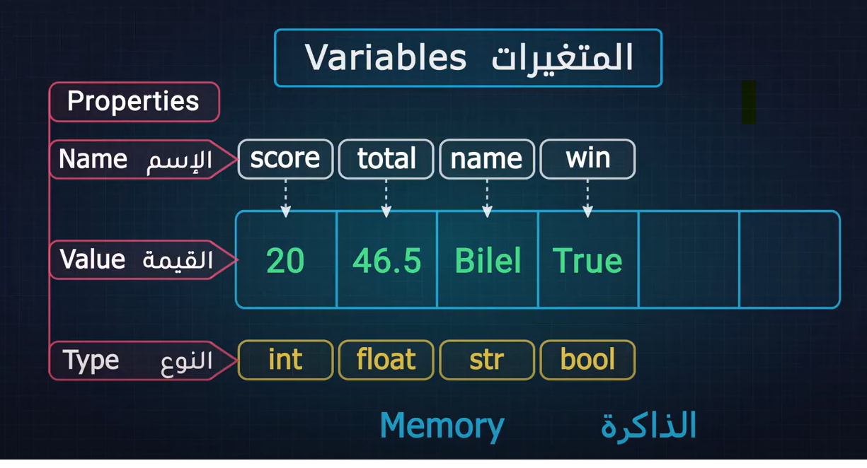
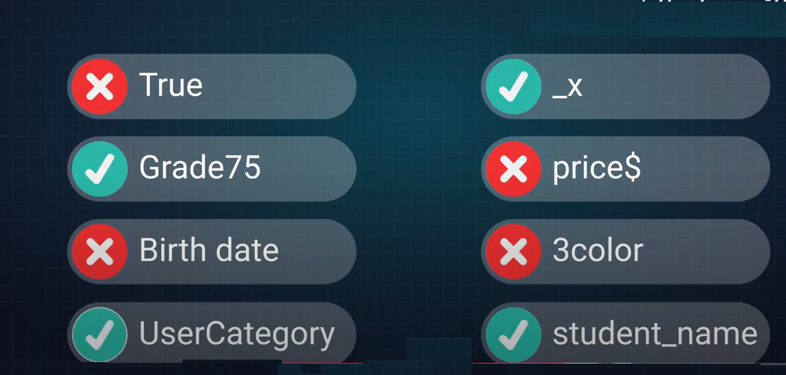
Python for Beginners with applications – Lesson 01
1.
Introduction & Background
-
data types

Slide 20
Python for Beginners with applications – Lesson 01
1.
Introduction & Background
-
String data type
input | Method | output
"Hello WORLD" | .capitalize() | Hello World
"HELLO WORLD" | .lower() | hello world
"hello world" | .upper() | HELLO WORLD
‘Python’ | .center(10,’*’) | **Python**
"HELLO WORLD" | .count(‘L’) | 3
"HELLO WORLD" | .index(‘O’) | 4
"HELLO WORLD" | .find(‘OR’) | 7
’31/01/2025’ | .replace(‘/’, ’-’) | ’31-01-2025’
’31/01/2025’ | .split(‘/’) | [’31’, ‘01’, ‘2025’]
‘abc123’ | .isalnum() | True
‘12345’ | .isnumeric() | True
‘hello world’ | .islower() | True
‘HELLO WORLD’ | .isupper() | True

Slide 21
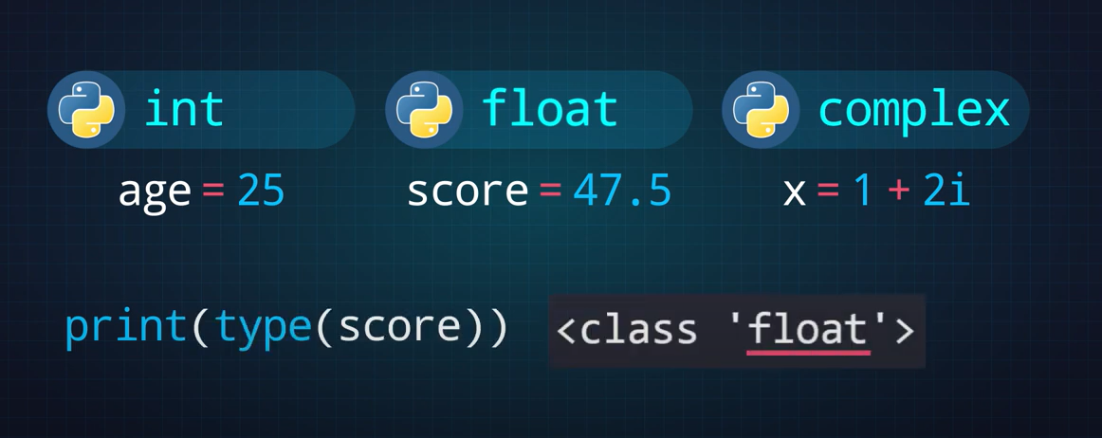
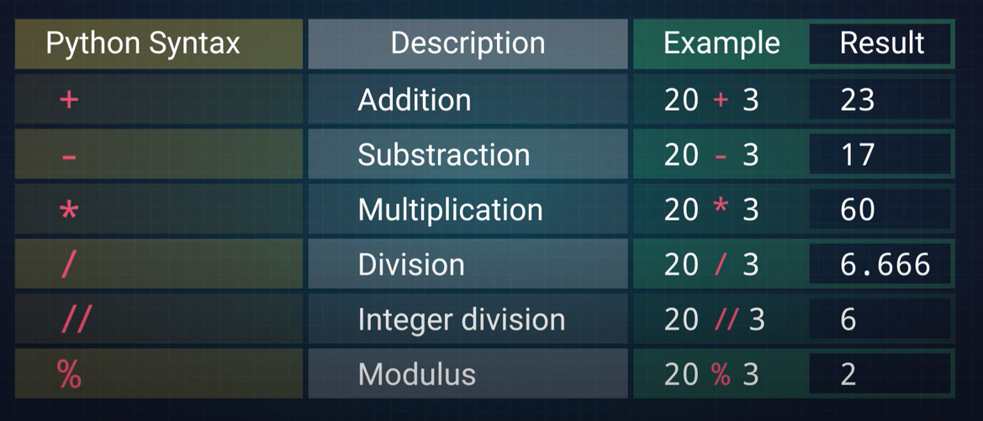
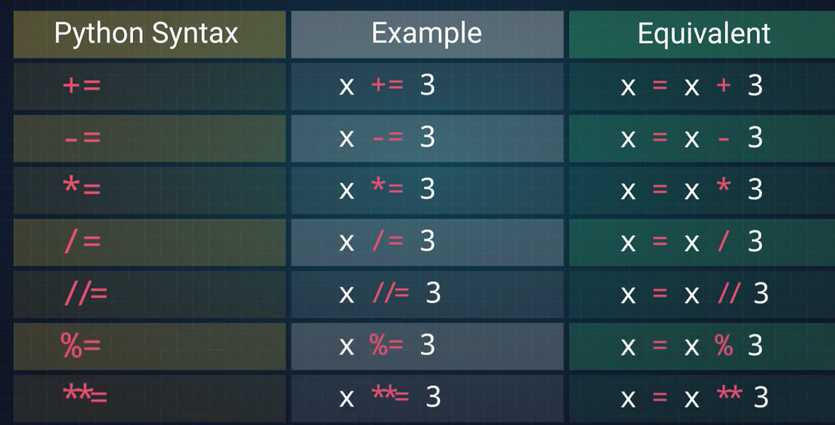
Python for Beginners with applications – Lesson 01
1.
Introduction & Background
-
numeric data types

Slide 22
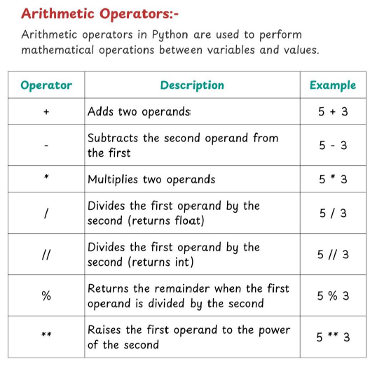
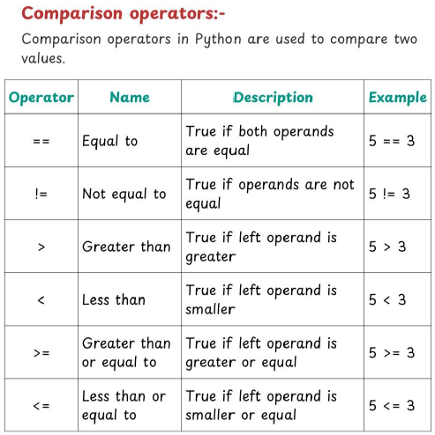
Python for Beginners with applications – Lesson 01
1.
Introduction & Background
-
Operators Cheat sheet

Slide 23
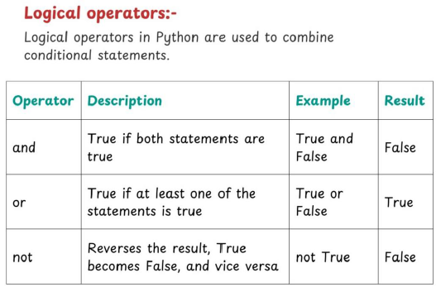
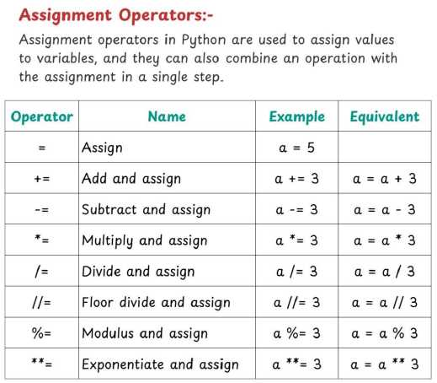
Python for Beginners with applications – Lesson 01
1.
Introduction & Background
-
Operators Cheat sheet

Slide 24
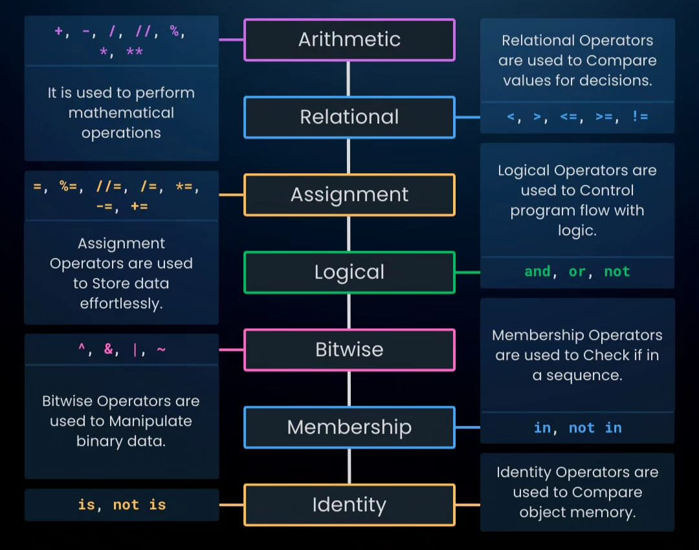
Python for Beginners with applications – Lesson 01
1.
Introduction & Background
-
Types of operators

Slide 25
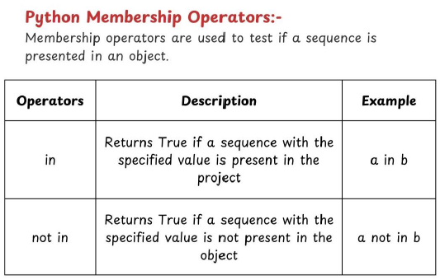
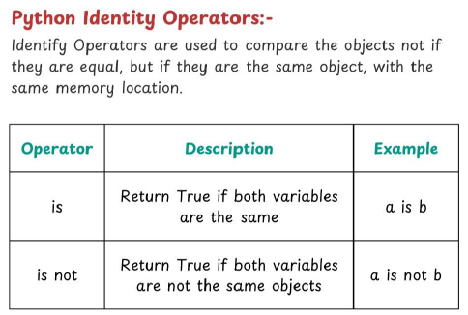
Python for Beginners with applications – Lesson 01
1.
Introduction & Background
-
Operators Cheat sheet

Slide 26
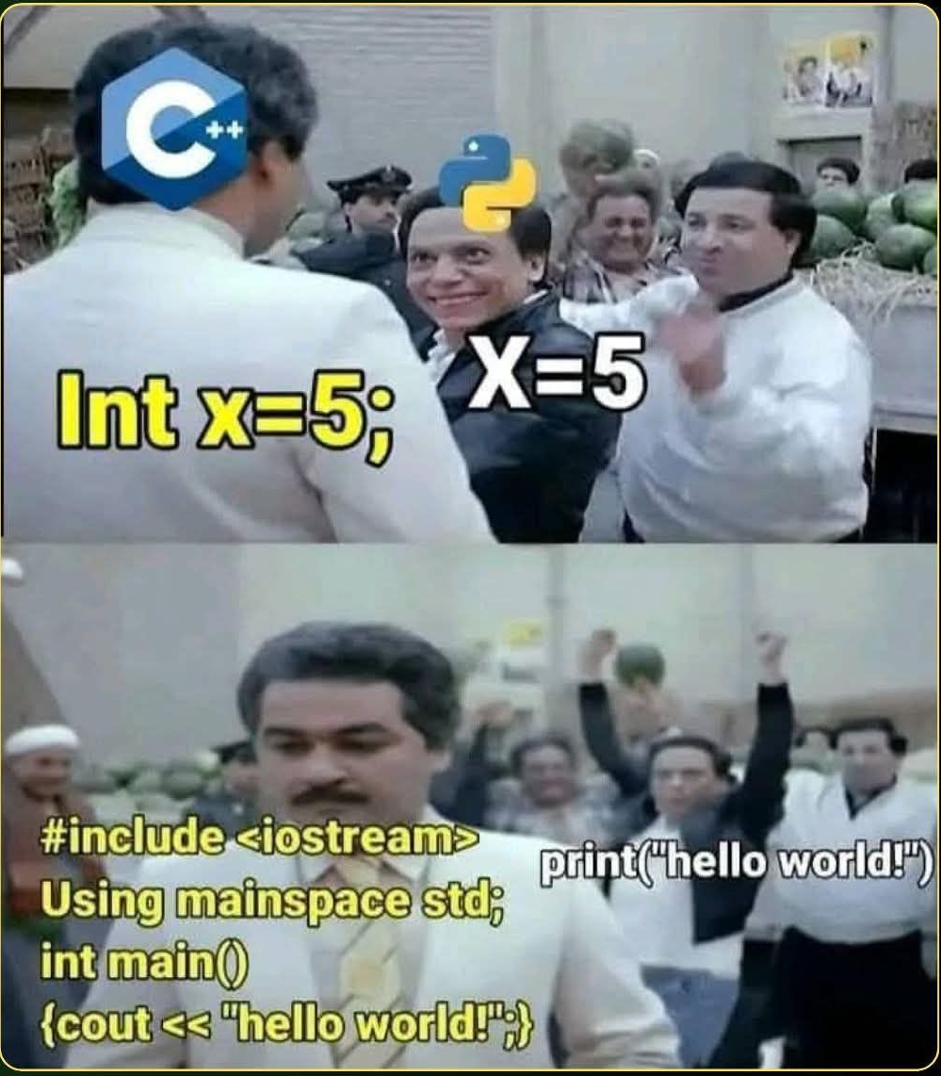
Python for Beginners with applications – Lesson 01
1.
Introduction & Background
-
Operators Cheat sheet

Slide 27
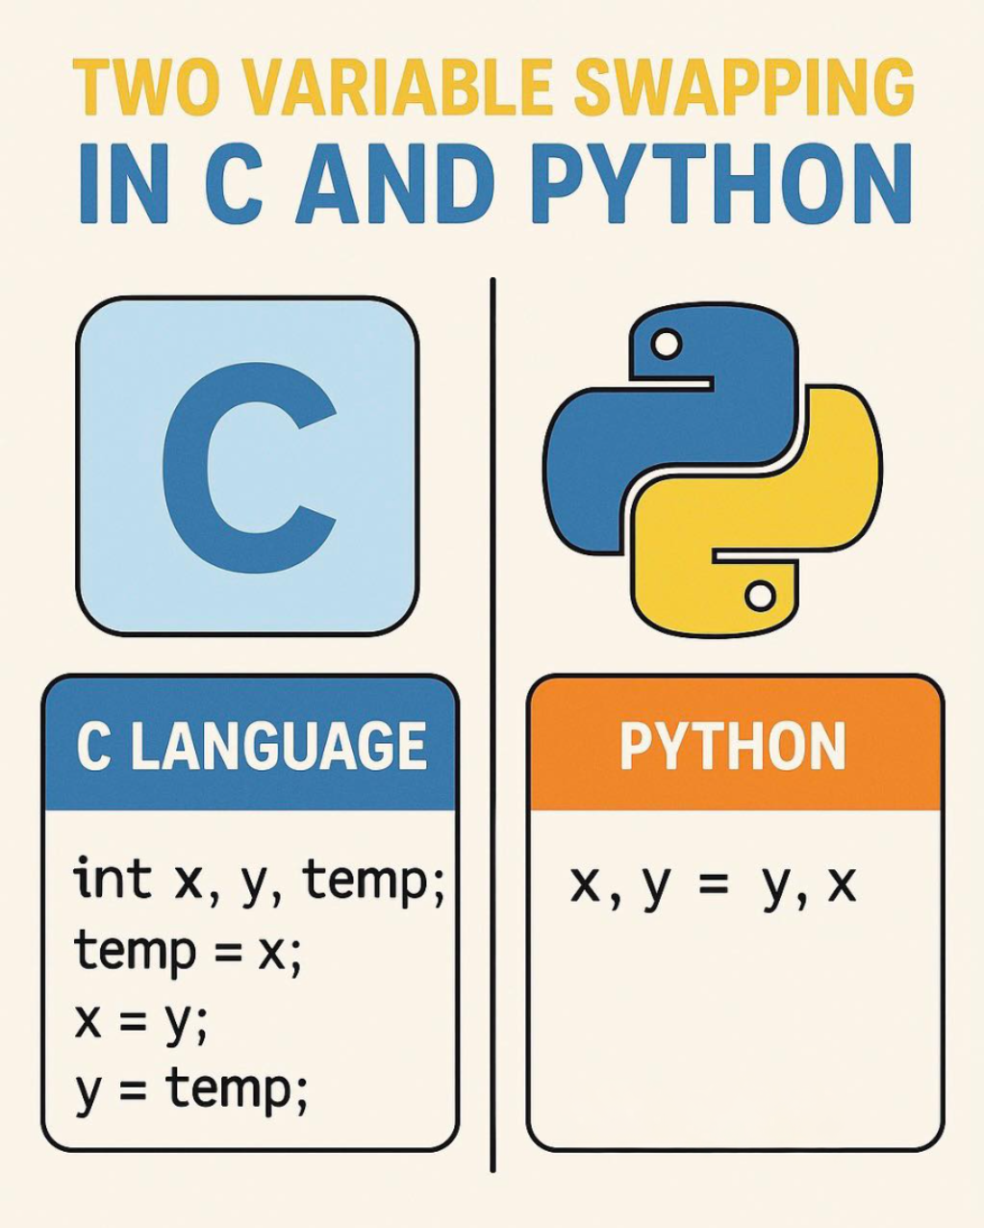

Python for Beginners with applications – Lesson 01
1.
Introduction & Background
-
Operators Cheat sheet

Slide 28
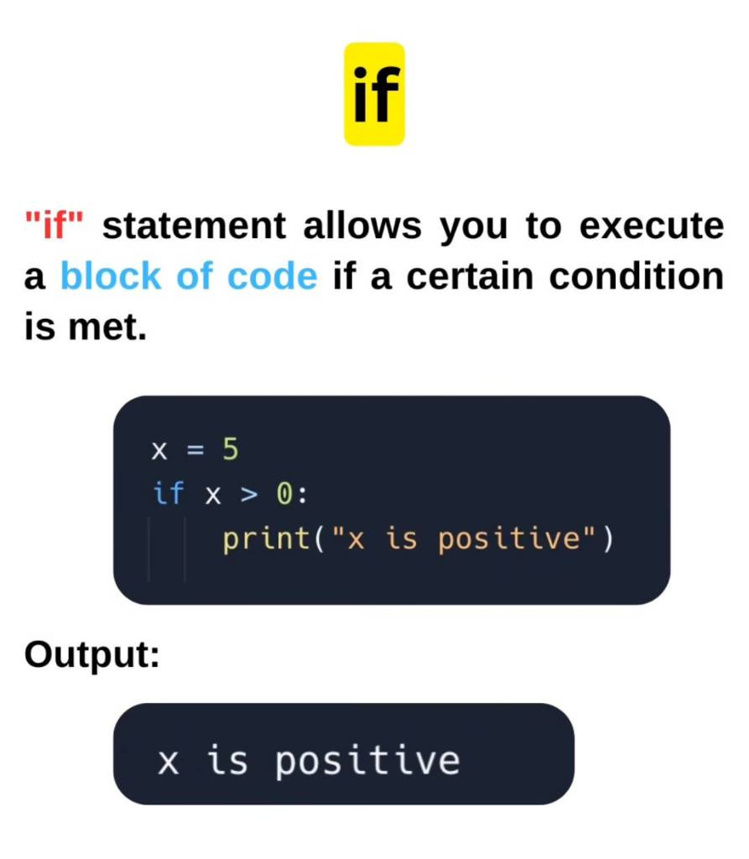
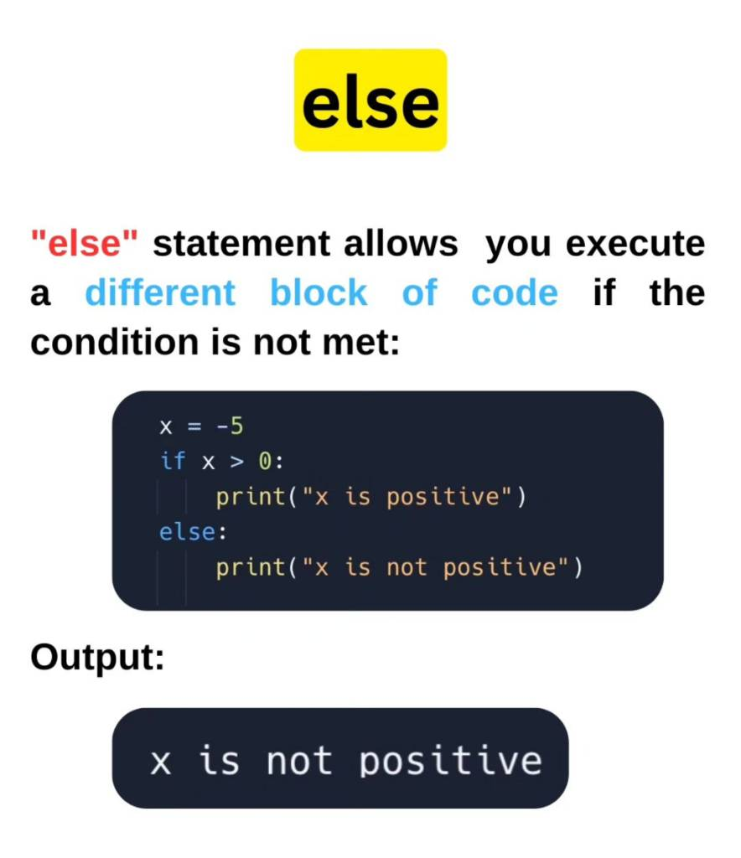
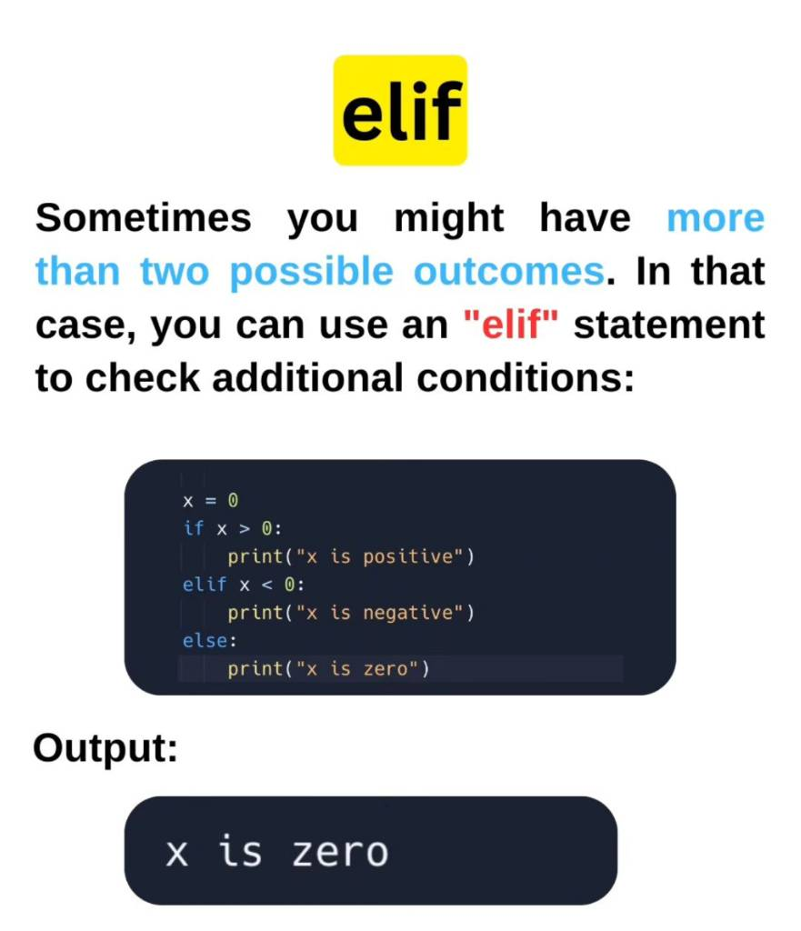
Python for Beginners with applications – Lesson 01
1.
Introduction & Background
-
Operators Cheat sheet

Slide 29
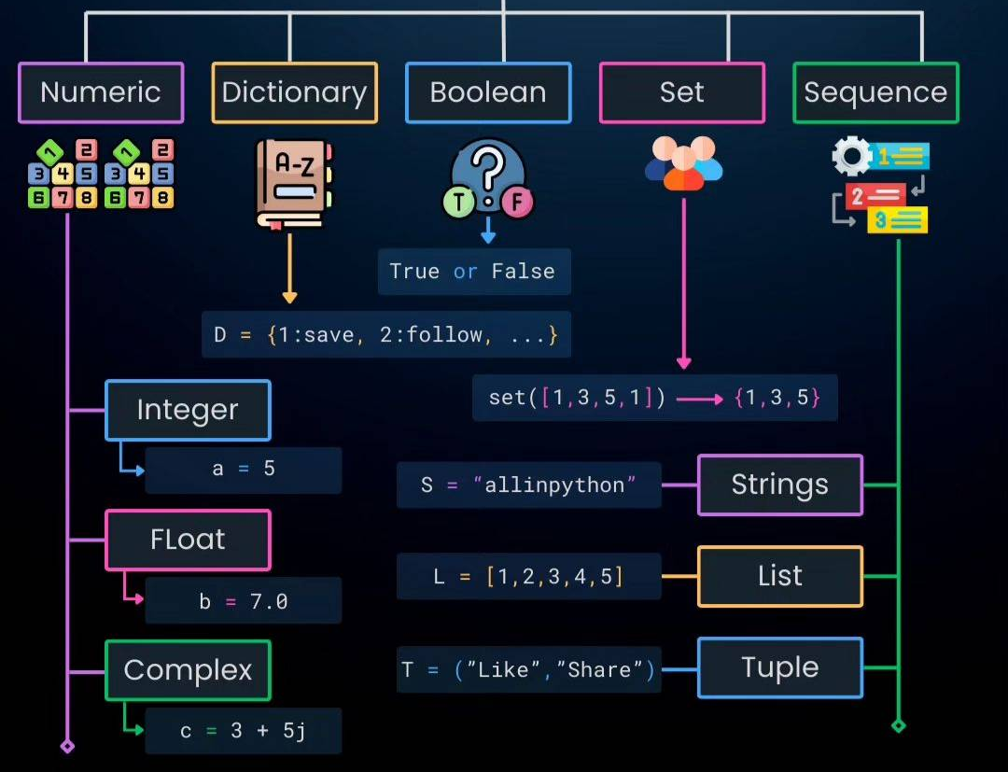
Python for Beginners with applications – Lesson 01
1.
Introduction & Background
-
Data types

Slide 30
Python for Beginners with applications – Lesson 01
1.
Introduction & Background
-
Data types
There are different types of data in Python. Some built-in Python data types are:
Numeric data types: int, float, complex
String data types: str
Sequence types: list, tuple, range, generator
Binary types: bytes, bytearray, memoryview
Mapping data type: dict
Boolean type: bool
Set data types: set, frozenset

Slide 31
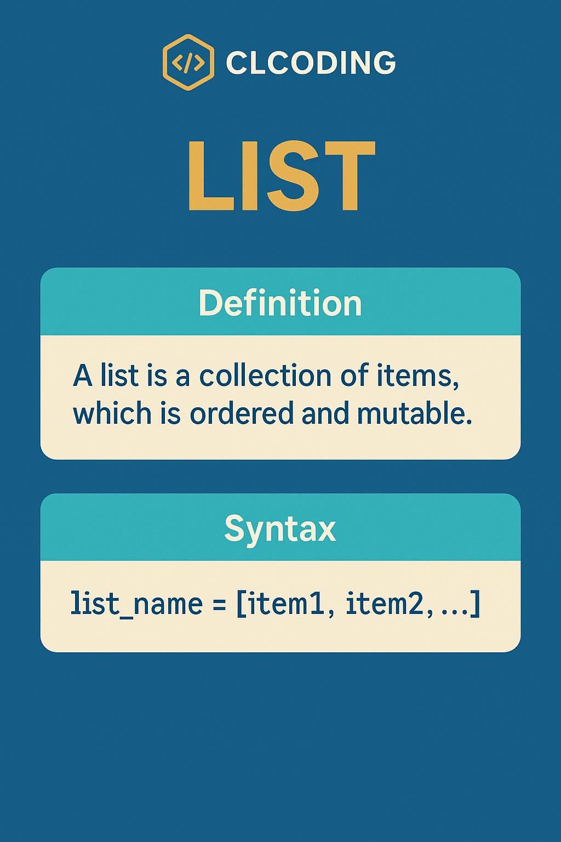
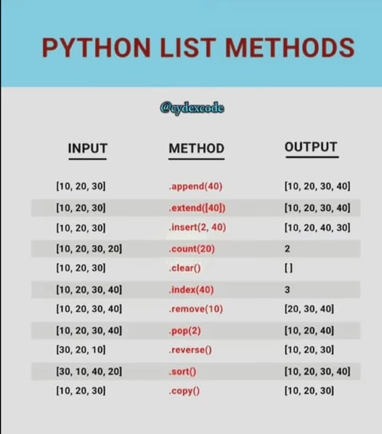
Python for Beginners with applications – Lesson 01
1.
Introduction & Background
-
Data types

Slide 32
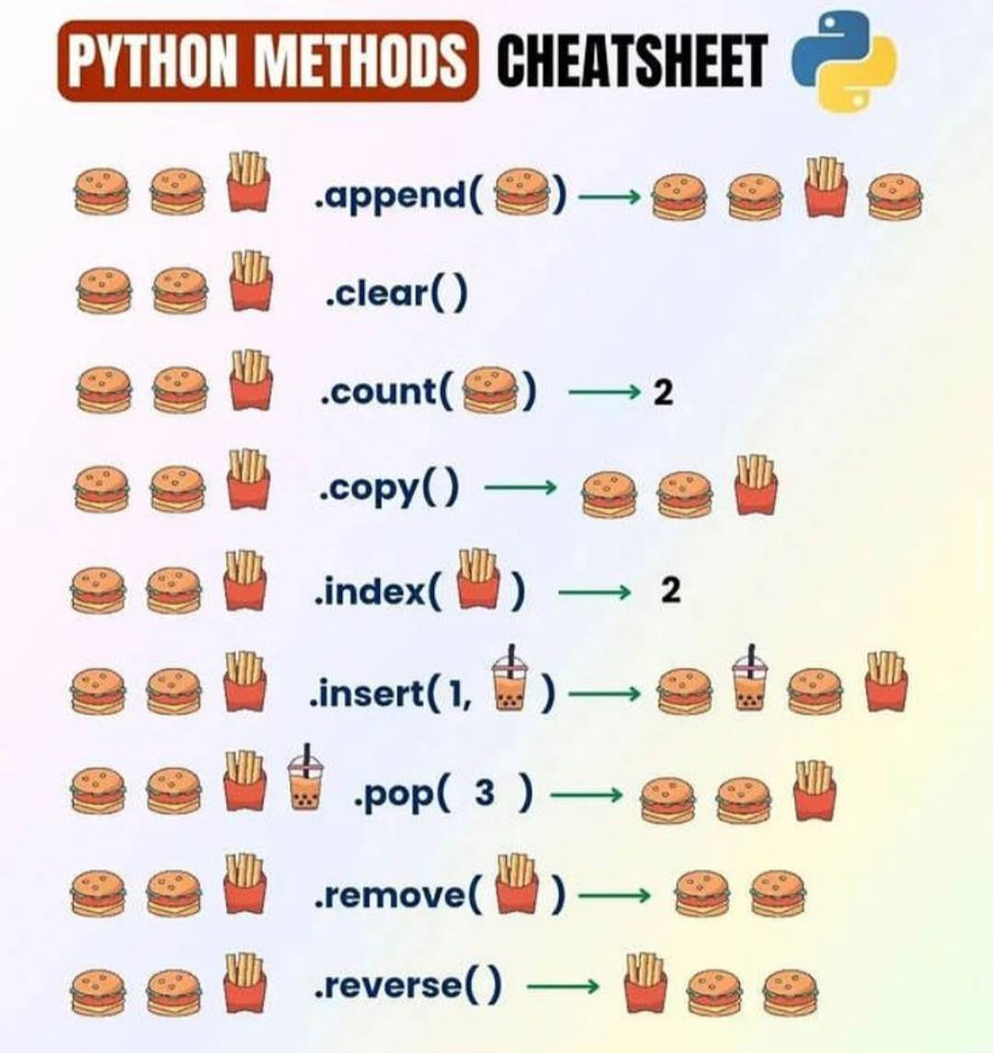
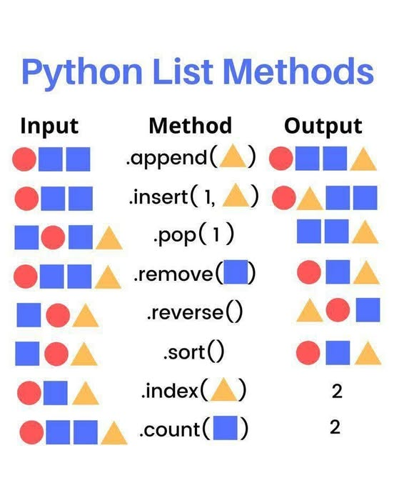
Python for Beginners with applications – Lesson 01
1.
Introduction & Background
-
Data types

Slide 33
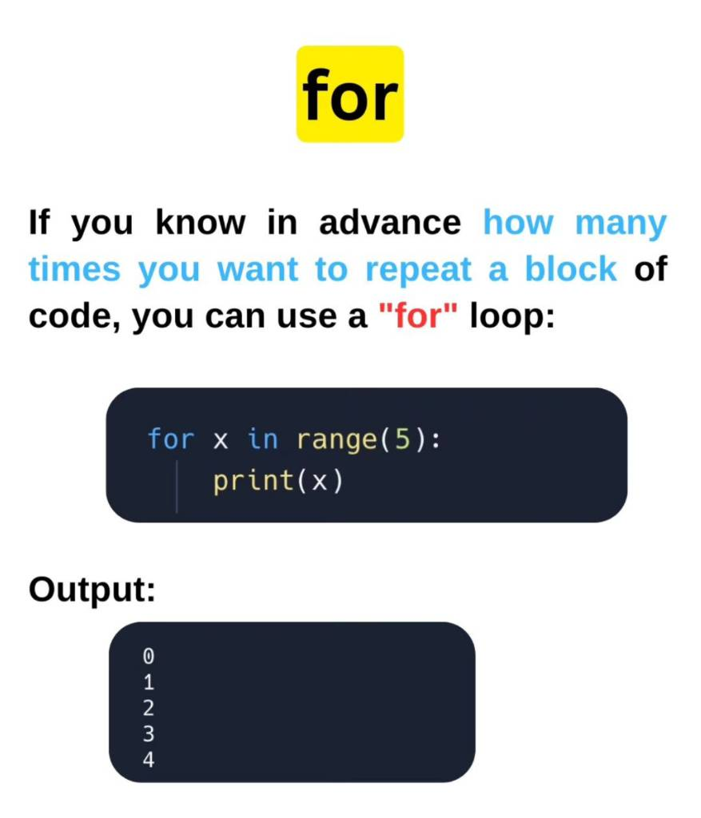
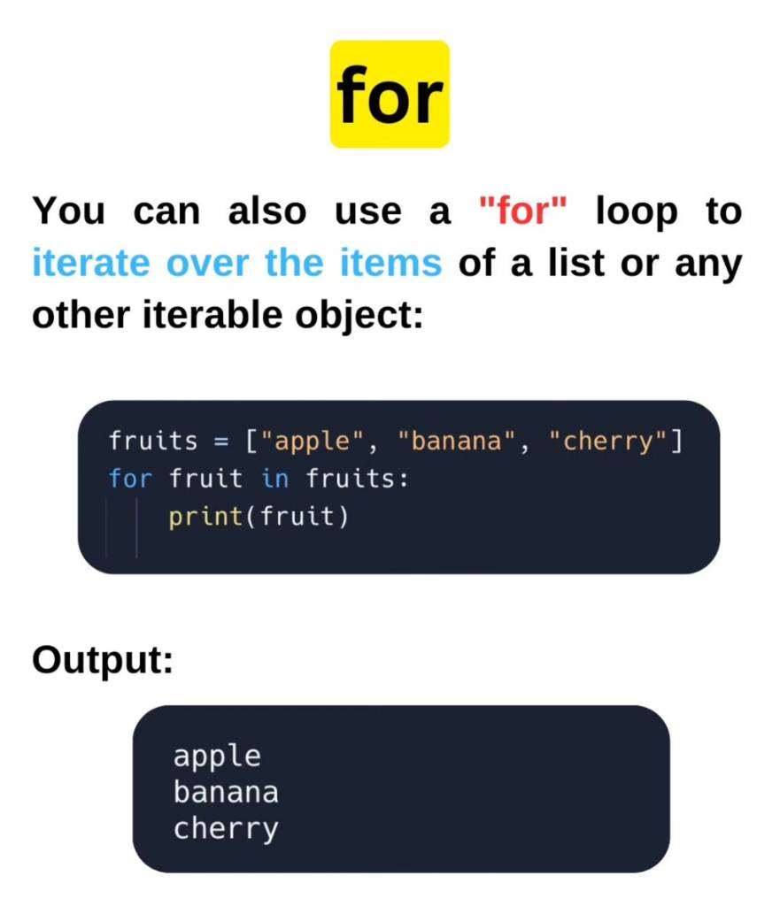
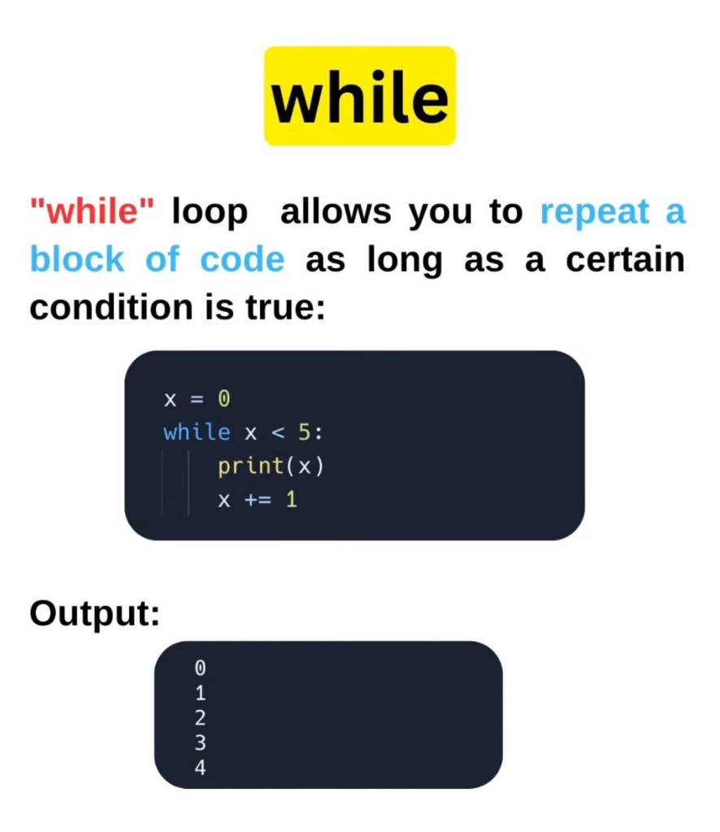
Python for Beginners with applications – Lesson 01
1.
Introduction & Background
-
Loops

Slide 34
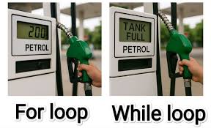
Python for Beginners with applications – Lesson 01
1.
Introduction & Background
-
Loops

Slide 35
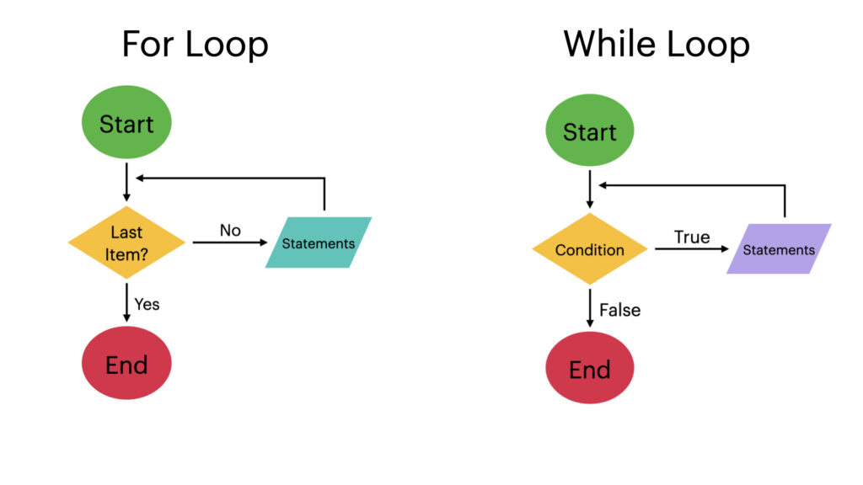
Python for Beginners with applications – Lesson 01
1.
Introduction & Background
-
Loops

Slide 36
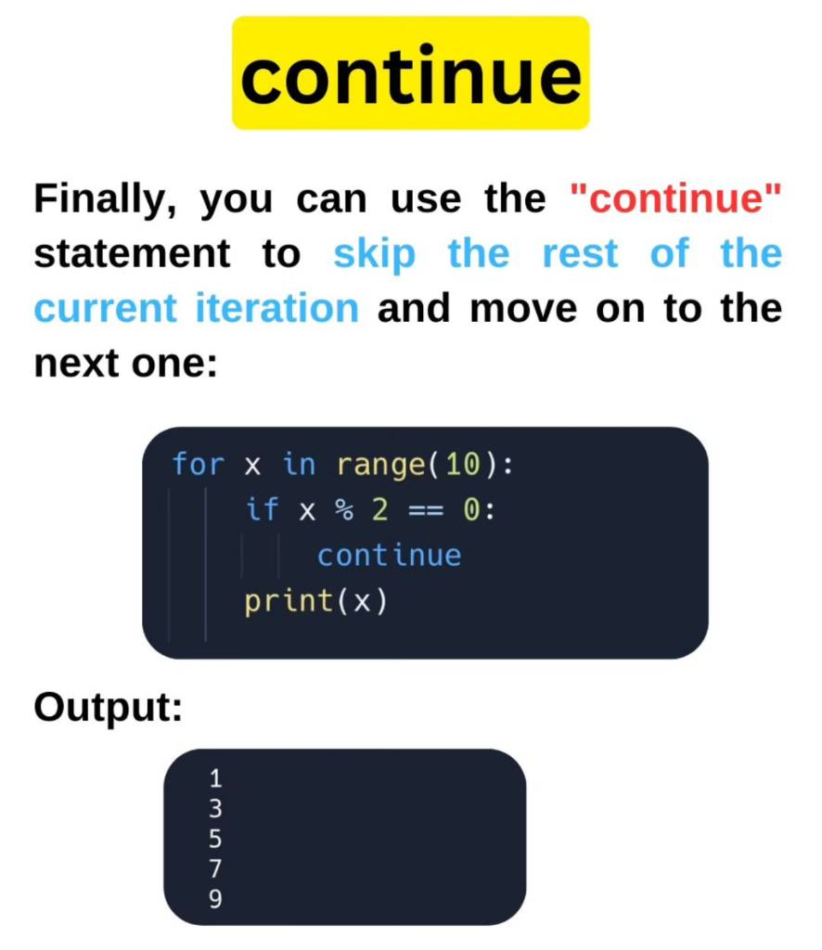
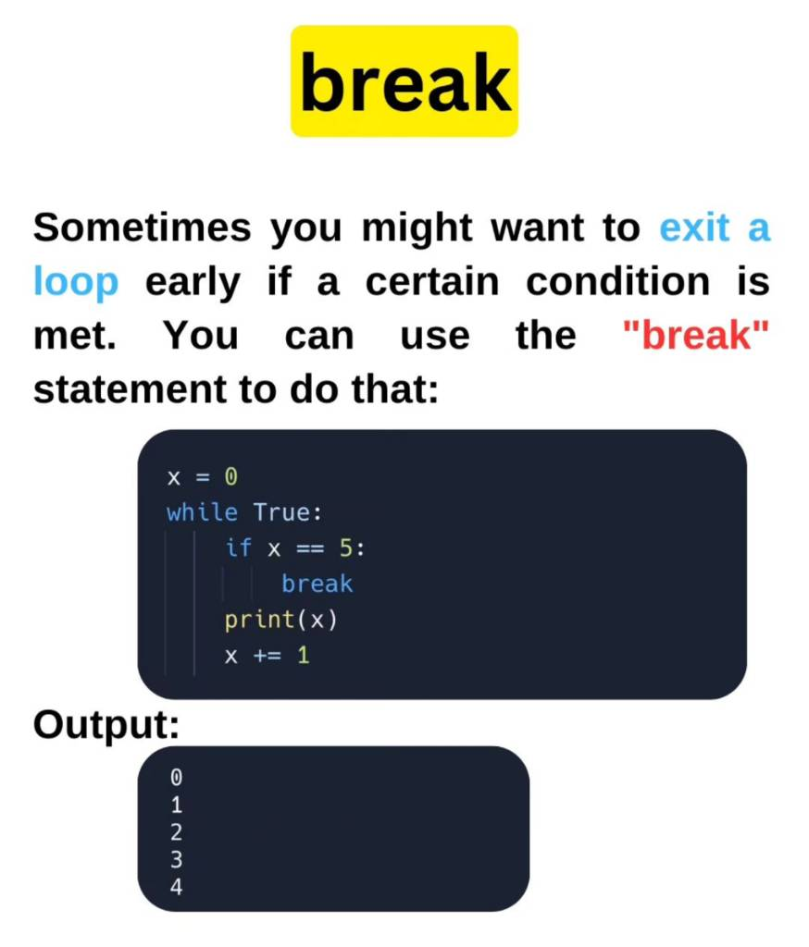
Python for Beginners with applications – Lesson 01
1.
Introduction & Background
-
Loops

Slide 37
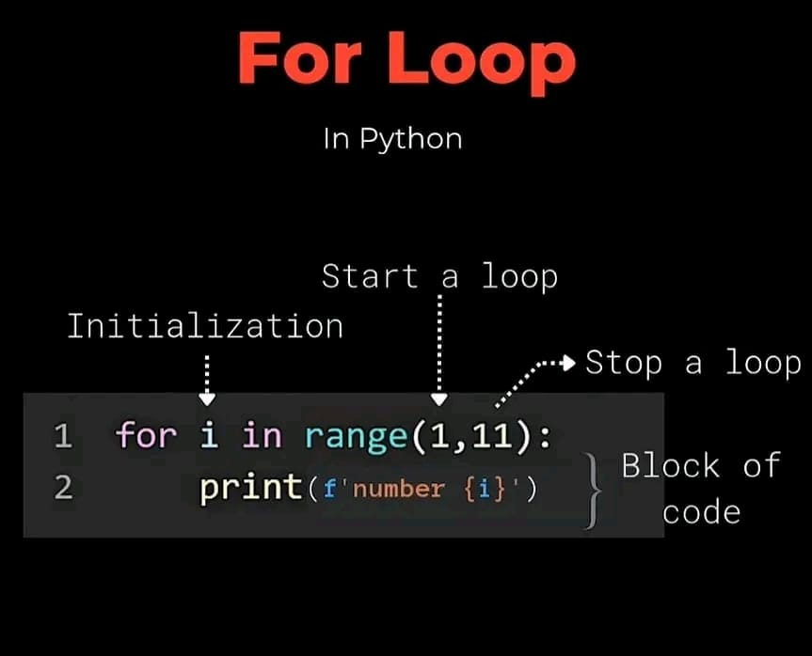
Python for Beginners with applications – Lesson 01
1.
Introduction & Background
-
Loops

Slide 38
Python for Beginners with applications – Lesson 01
1.
Introduction & Background
-
Functions
Functions in Python
How to define functions in Python 3

Slide 39
Python for Beginners with applications – Lesson 01
1.
Introduction & Background
-
Functions
Introduction
A function is a block of instructions that performs an action and, once defined, can be reused. Functions make code more modular, allowing you to use the same code over and over again.
Python has a number of built-in functions that you may be familiar with, including:
print() which will print an object to the terminal
int() which will convert a string or number data type to an integer data type
len() which returns the length of an object
Function names include parentheses and may include parameters (arguments).
we’ll go over how to define your own functions to use in your coding projects

Slide 40

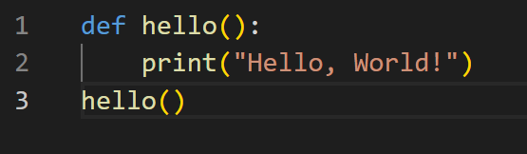
Python for Beginners with applications – Lesson 01
1.
Introduction & Background
-
Functions
Defining a Function
A function is defined by using the def keyword, followed by a name of your choosing, followed by a set of parentheses which hold any parameters the function will take (they can be empty), and ending with a colon.
Our function is now fully defined, but if we run the program at this point, nothing will happen since we didn’t call the function.

Slide 41


Python for Beginners with applications – Lesson 01
1.
Introduction & Background
-
Functions
Working with Parameters

Slide 42

Python for Beginners with applications – Lesson 01
1.
Introduction & Background
-
Functions
Returning a value
You can pass a parameter value into a function, and a function can also produce a value.
A function can produce a value with the return statement, which will exit a function and optionally pass an expression back to the caller. If you use a return statement with no arguments, the function will return None.

